Slide 1
Facebook

Slide 2
Facebook is an intermediary - a platform that connects people/communities
Enforcement against Content;
Community Standard- The rules of engagement of the platform which are publicly available. It covers aspects such as Hate Speech, Misinformation, Graphic content, Bullying, Nudity etc.
Local Laws
Notes:
Section 230 of the Communications Decency Act - defines an intermediary as not being a publisher.
Enforcement against CS is generally reactive. Hate Speech and Nudity can be captured at a very early stage.
We need a court order to enforce against content that violates local law.

Slide 3
“a direct attack on people based on what we call protected characteristics — race, ethnicity, national origin, religious affiliation, sexual orientation, caste, sex, gender, gender identity, and serious disease or disability. We also provide some protections for immigration status. We define attack as violent or dehumanizing speech, statements of inferiority, or calls for exclusion or segregation. We separate attacks into three tiers of severity, as described below.”
Hate Speech
Notes:
The definition is based on international standards.
You can look at the Community Standards Enforcement Report which speaks to the success of our enforcement.
Our experience in Sri Lanka – Post March 2018, Easter Sunday. Enforcement when

Slide 4
Fake News
Disrupting economic incentives for people, Pages, and domains that propagate misinformation
Reducing the distribution of content rated as false by independent third-party fact-checkers
Empowering people to decide for themselves what to read, trust, and share by informing them with more context and promoting news liter-acy
Collaborating with academics and other organizations to help solve this challenging issue
Notes:
Disrupt Reduce and Inform

Slide 5
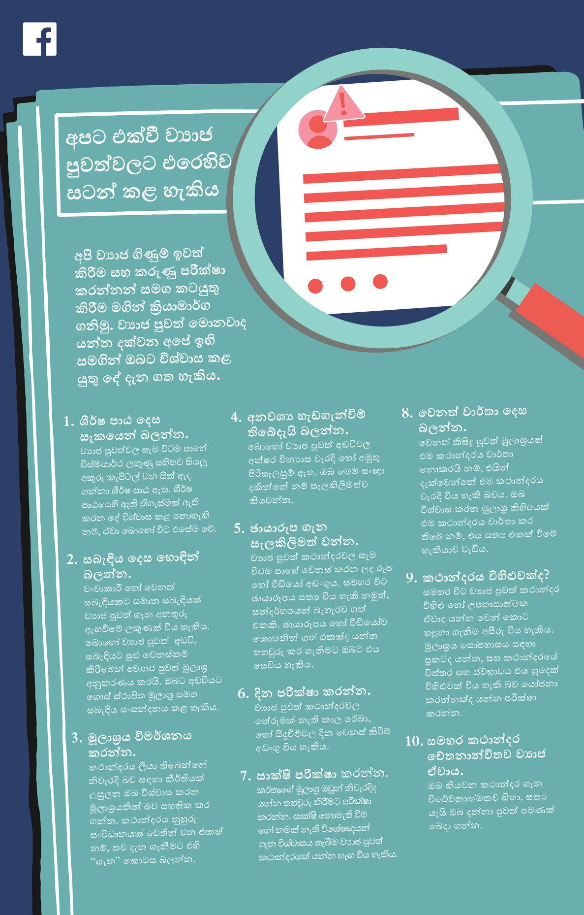
Public awareness tips on spotting fake news, published in newspapers Quick Promotions on each Facebook page on how to spot fake news.
Notes:
Advertisements in all Newspapers and QPs

Slide 6
Fake Accounts
Strict Enforcement against Fake accounts and inauthentic behavior
Taken Down over 5 Billion Fake Accounts up to the 3rd Quarter this year.
Enforcement against Fake Accounts
Blocking Accounts from being Created
Removing Accounts at the time of sign up.
Removing Accounts already on the Platforms.
Notes:
We look at signals to identify possible points of generation of Fake Accounts. Eg- IP Addresses are blocked which can be used to create fake accounts. Preventing the creation of accounts is the the key goal here.
Signals to identify Fake Accounts at the time of sign up.
This is more reactive. When users report we examine the account and action depending on the signals we get.

Slide 7
What we have done in Sri Lanka Community Engagement Increased language review capacity Research on the ground to understand issues of racial & religious identity politics Community Partner Network User Reports Increased Machine Learning/AI Capacity New Products

Slide 8
Thank You

